Slide 1
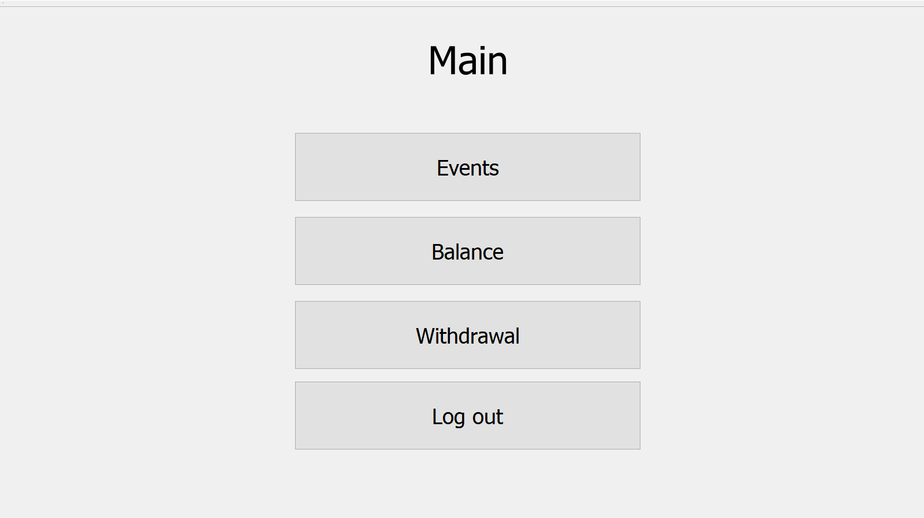
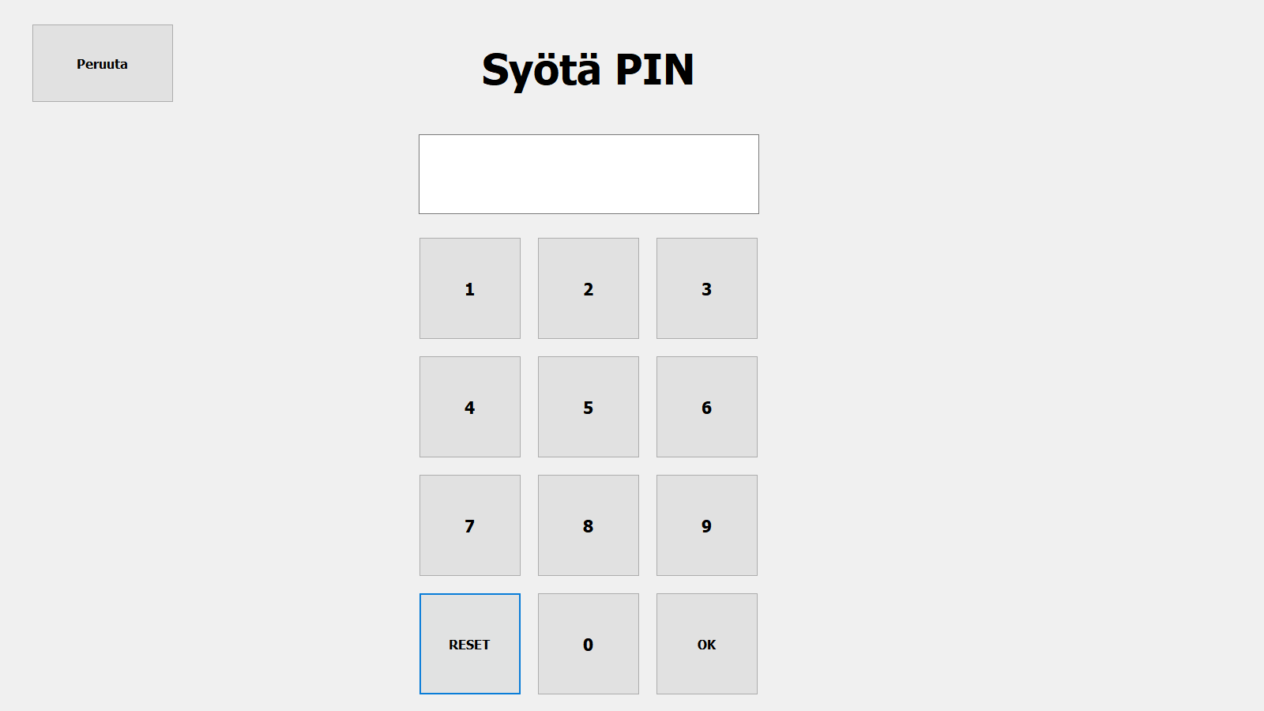
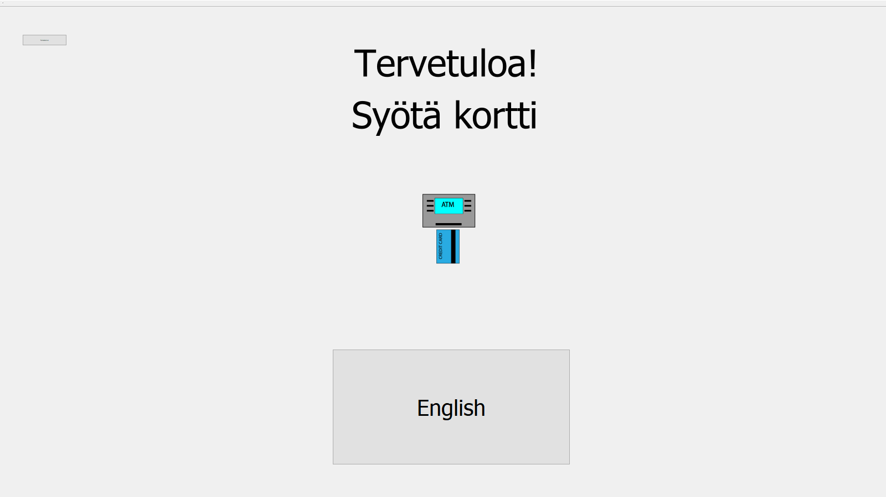
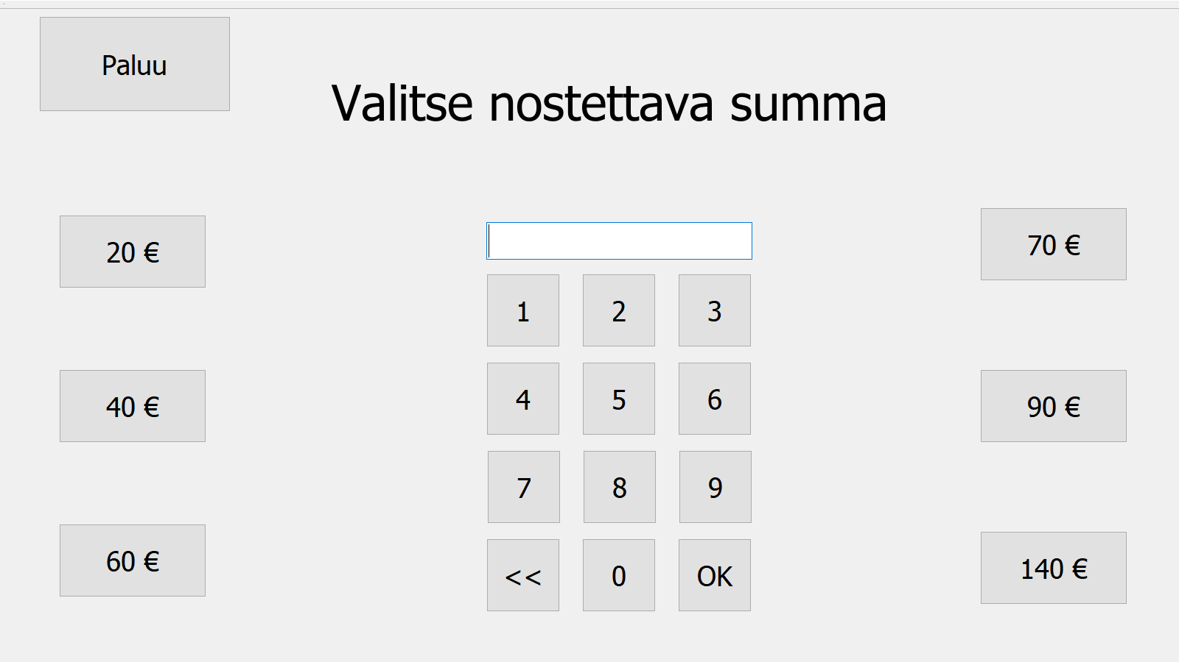
BankSimul
Mika Hartikka, Veetu Kyllönen, Tuomas Leipivaara, Tapani Silvola, TVT18SPO, Group 200
Oulu University of Applied Sciences, Information Technology, Software Engineering
Introduction
The objective of this project was to make an ATM application with few common functions. The user interface was implemented with a touch screen.
FIGURE 1. Welcome screen
Objectives
The requirements for the application were an ability to check account balance and account events and also withdraw money. It was not required to print receipts or to be able to actually withdraw money in this demo version. Our own addition to features was the possibility to change language between Finnish and English. The application uses a MySQL database where all the user data is stored.
Methods
The system contains a computer, an RFID card and a reader, the touch screen and the MySQL database.
FIGURE 2. Login screen
Firstly, user is able to change language and is asked to insert the RFID card to the reader (FIGURE 1). If the card is valid, a keyboard will appear on the screen and the user is asked to enter a PIN code (FIGURE 2). Secondly, if the login is accepted, the main window will be shown on the touch screen (FIGURE 3). Thirdly, user can choose from the previously mentioned actions. Lastly, the user can log out from the system or if the user withdraws money, the user will be logged out automatically (FIGURE 4).
Results
The system worked exactly as planned. All the implementions were successfully incorporated to the final system.
FIGURE 3. Main window
Conclusions
The project work was challenging but not overwhelming. Also, all of the objectives set at the beginning were achieved.
FIGURE 4. Withdrawal view
References
Qt information source:
https://www.qt.io
Software Development Application Project
ECTS credits: 6
Date of publication: 2019, Spring
Instructor: Eero Nousiainen

